Slide 1

The
Mole

Slide 2

Jesus fed the masses with five loaves and two fish on the shores of the the Sea of Galilee ……..but………..

Slide 3
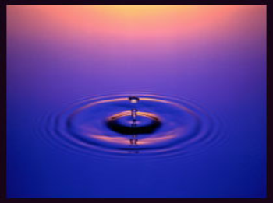
……What could Jesus have done with a drop of water?

Slide 4
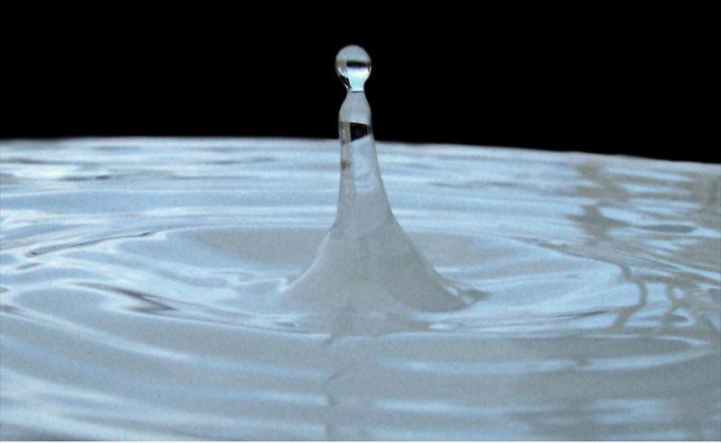
1 drop of water = 0.1mL = 0.1g of H₂O
18g of H₂O = 1mol = 6.02 x 10²³ molecules
0.1g of H₂O = 0.0055 mol = 3.34 x 10²¹ molecules
World population = 6 billion = 6 x 10⁹
# molecules / person = 557 410 000 000

